Slide 1
Sovereign Bitcoiner #03
Underneath the consensus
The P2P protocol

Slide 2

Who am I?

Slide 3
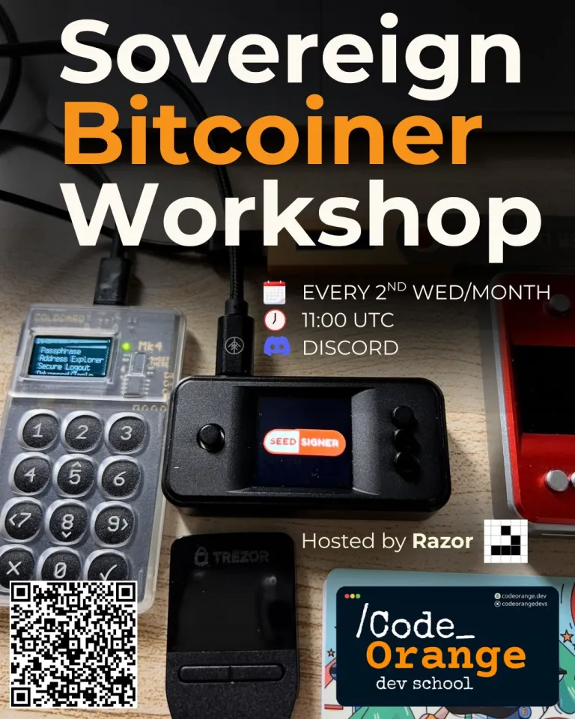
Independence. Be the monarch of your life.

Slide 4
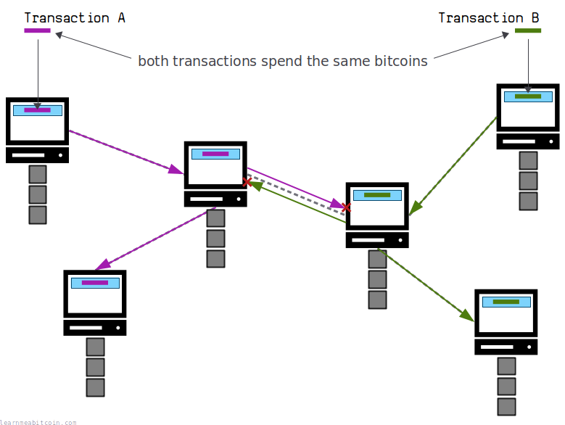
Last time: miners

Slide 5
How do you find peers?
Ask the audience
?
?
?
Notes:
Here it was needed to explain what an IP is, and what a listener node is. I found it hard to properly do it to a non-technical audience, without starting to talk about networking. I think the analogy with house addresses is pretty good. Someone mentioned Bluetooth - I’ve never heard about Bitcoin over Bluetooth, but it would be a cool thing.

Slide 6
How do you find peers?
Each peer has an IP:port
DNS seed bootstrapping:
E.g. seed.bitcoin.sipa.be, dnsseed.bluematt.me
Hardcoded seed nodes
Addresses stored in a previous session (peers.dat)
Gossip with other peers
Manually adding a node’s address
Peers connecting to you after they have learned your address

Slide 7
Types of node addresses
IPv4/IPv6
Tor
I2P
Yggdrassil (very unpopular)

Slide 8
Properties of Bitcoin
Ask the audience
?
?
?
?
?
?
?
?
?
Hint: Mastering Bitcoin book, chapter 14
Notes:
Keep the split. Someone asked what is immutability. Someone also mentioned that it’s not physical.

Slide 9
Properties of Bitcoin
Consensus
Non-consensus
Accounting/correctness
No double spend
Authorization/ownership
Integrity
Neutrality
Predictable issuance
Secure timestamping
Nonexpiration
Discrete units of value
Timelocking
Forgery protection
No double spend
Immutability
Replication
Censorship resistance
Consistency
Trust minimization
Global access
Pseudonimity
Hint: Mastering Bitcoin book, chapter 14

Slide 10
Ensured by the network and economical incentives
No double spend
Immutability (blocks can’t be modified)
Replication
Censorship resistance
Blocks can’t be reordered
Trust minimization
Global access
Pseudonimity

Slide 11
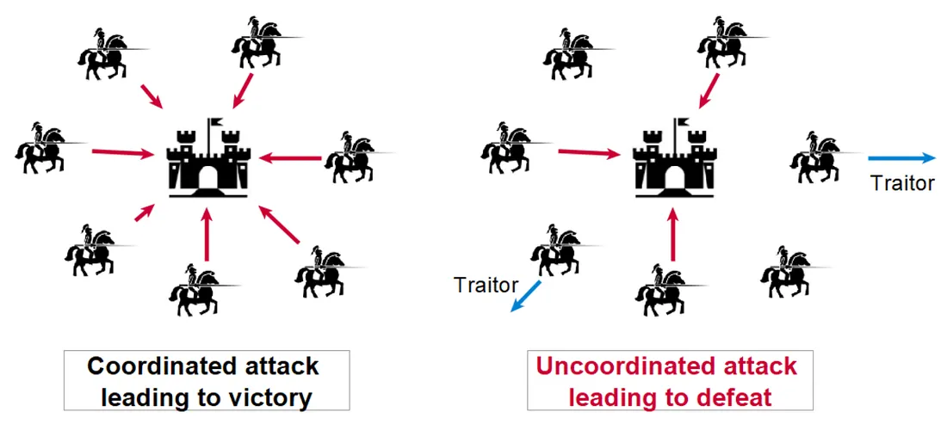
Byzantine Generals Problem

Slide 12
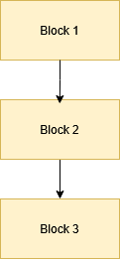

Slide 13
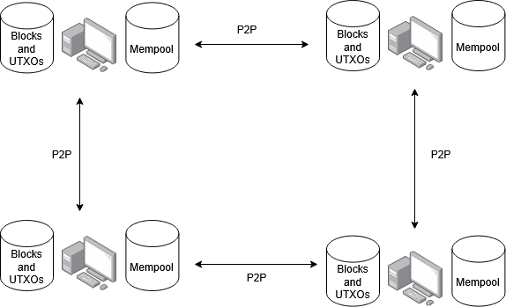
Bitcoin nodes

Slide 14
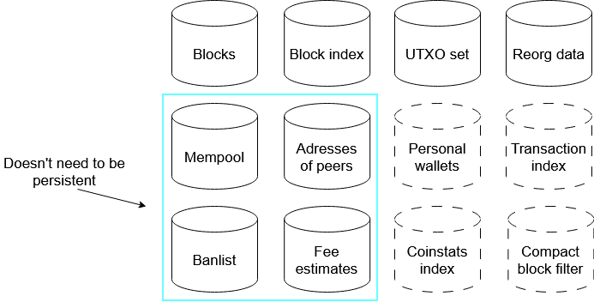
What is in a node?

Slide 15
Types of nodes
Full archival nodes (hold everything)
Pruned nodes (hold the last n blocks) - can be used by miners
Light client/SPV node
Any of them could be
Wallet/no wallet
Listening/non-listening

Slide 16
Risks of a true light node
From a peer with enough mining power:
Coins out of thin air
Double spends
Transactions signed with the wrong key
Less private

Slide 17
How does a light node mitigate the risks?
Neutrino: GetUtxo - follows the chain of utxos backwards
Electrum: back it up by a node
Compact block filters (BIP-157/BIP-158)
Bitcoin node -> Electrum server -> wallet (that connects to the server)

Slide 18
Compact block filters (BIP-157/BIP-158)
One filter: 15–25 KB per block
Ask the audience

Slide 19
Utreexo
Similar to how light clients use Electrum server, Utreexo relies on Esplora nodes
It stores UTXOs differently
https://telaviv2019.bitcoinedge.org/files/utreexo.pdf

Slide 20
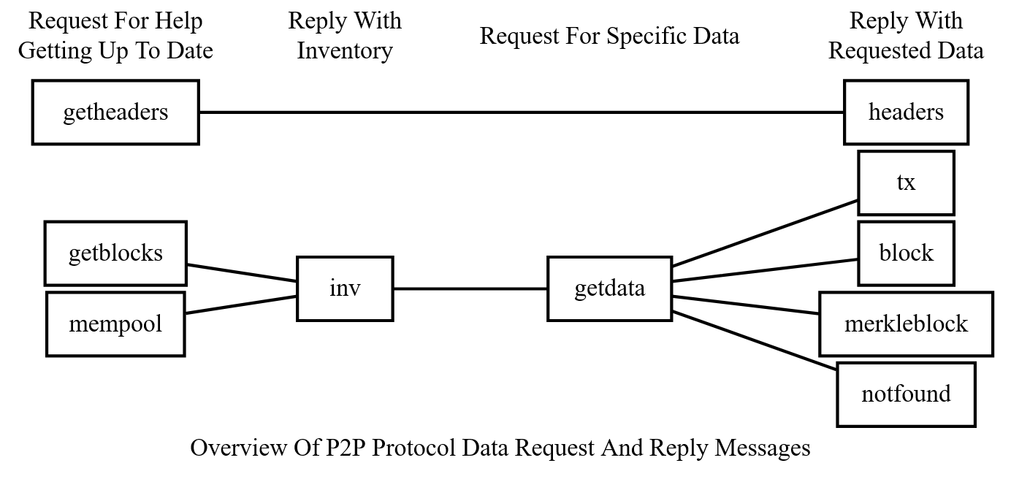
P2P messages
Source: https://developer.bitcoin.org/reference/p2p_networking.html

Slide 21
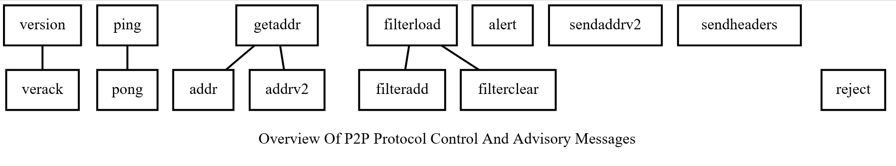
P2P messages
Source: https://developer.bitcoin.org/reference/p2p_networking.html

Slide 22
Censorship resistance
The P2P messages are sent unencrypted
The internet provider knows you are running a Bitcoin node
BIP-324 adds encryption (also called v2)

